Slide 1
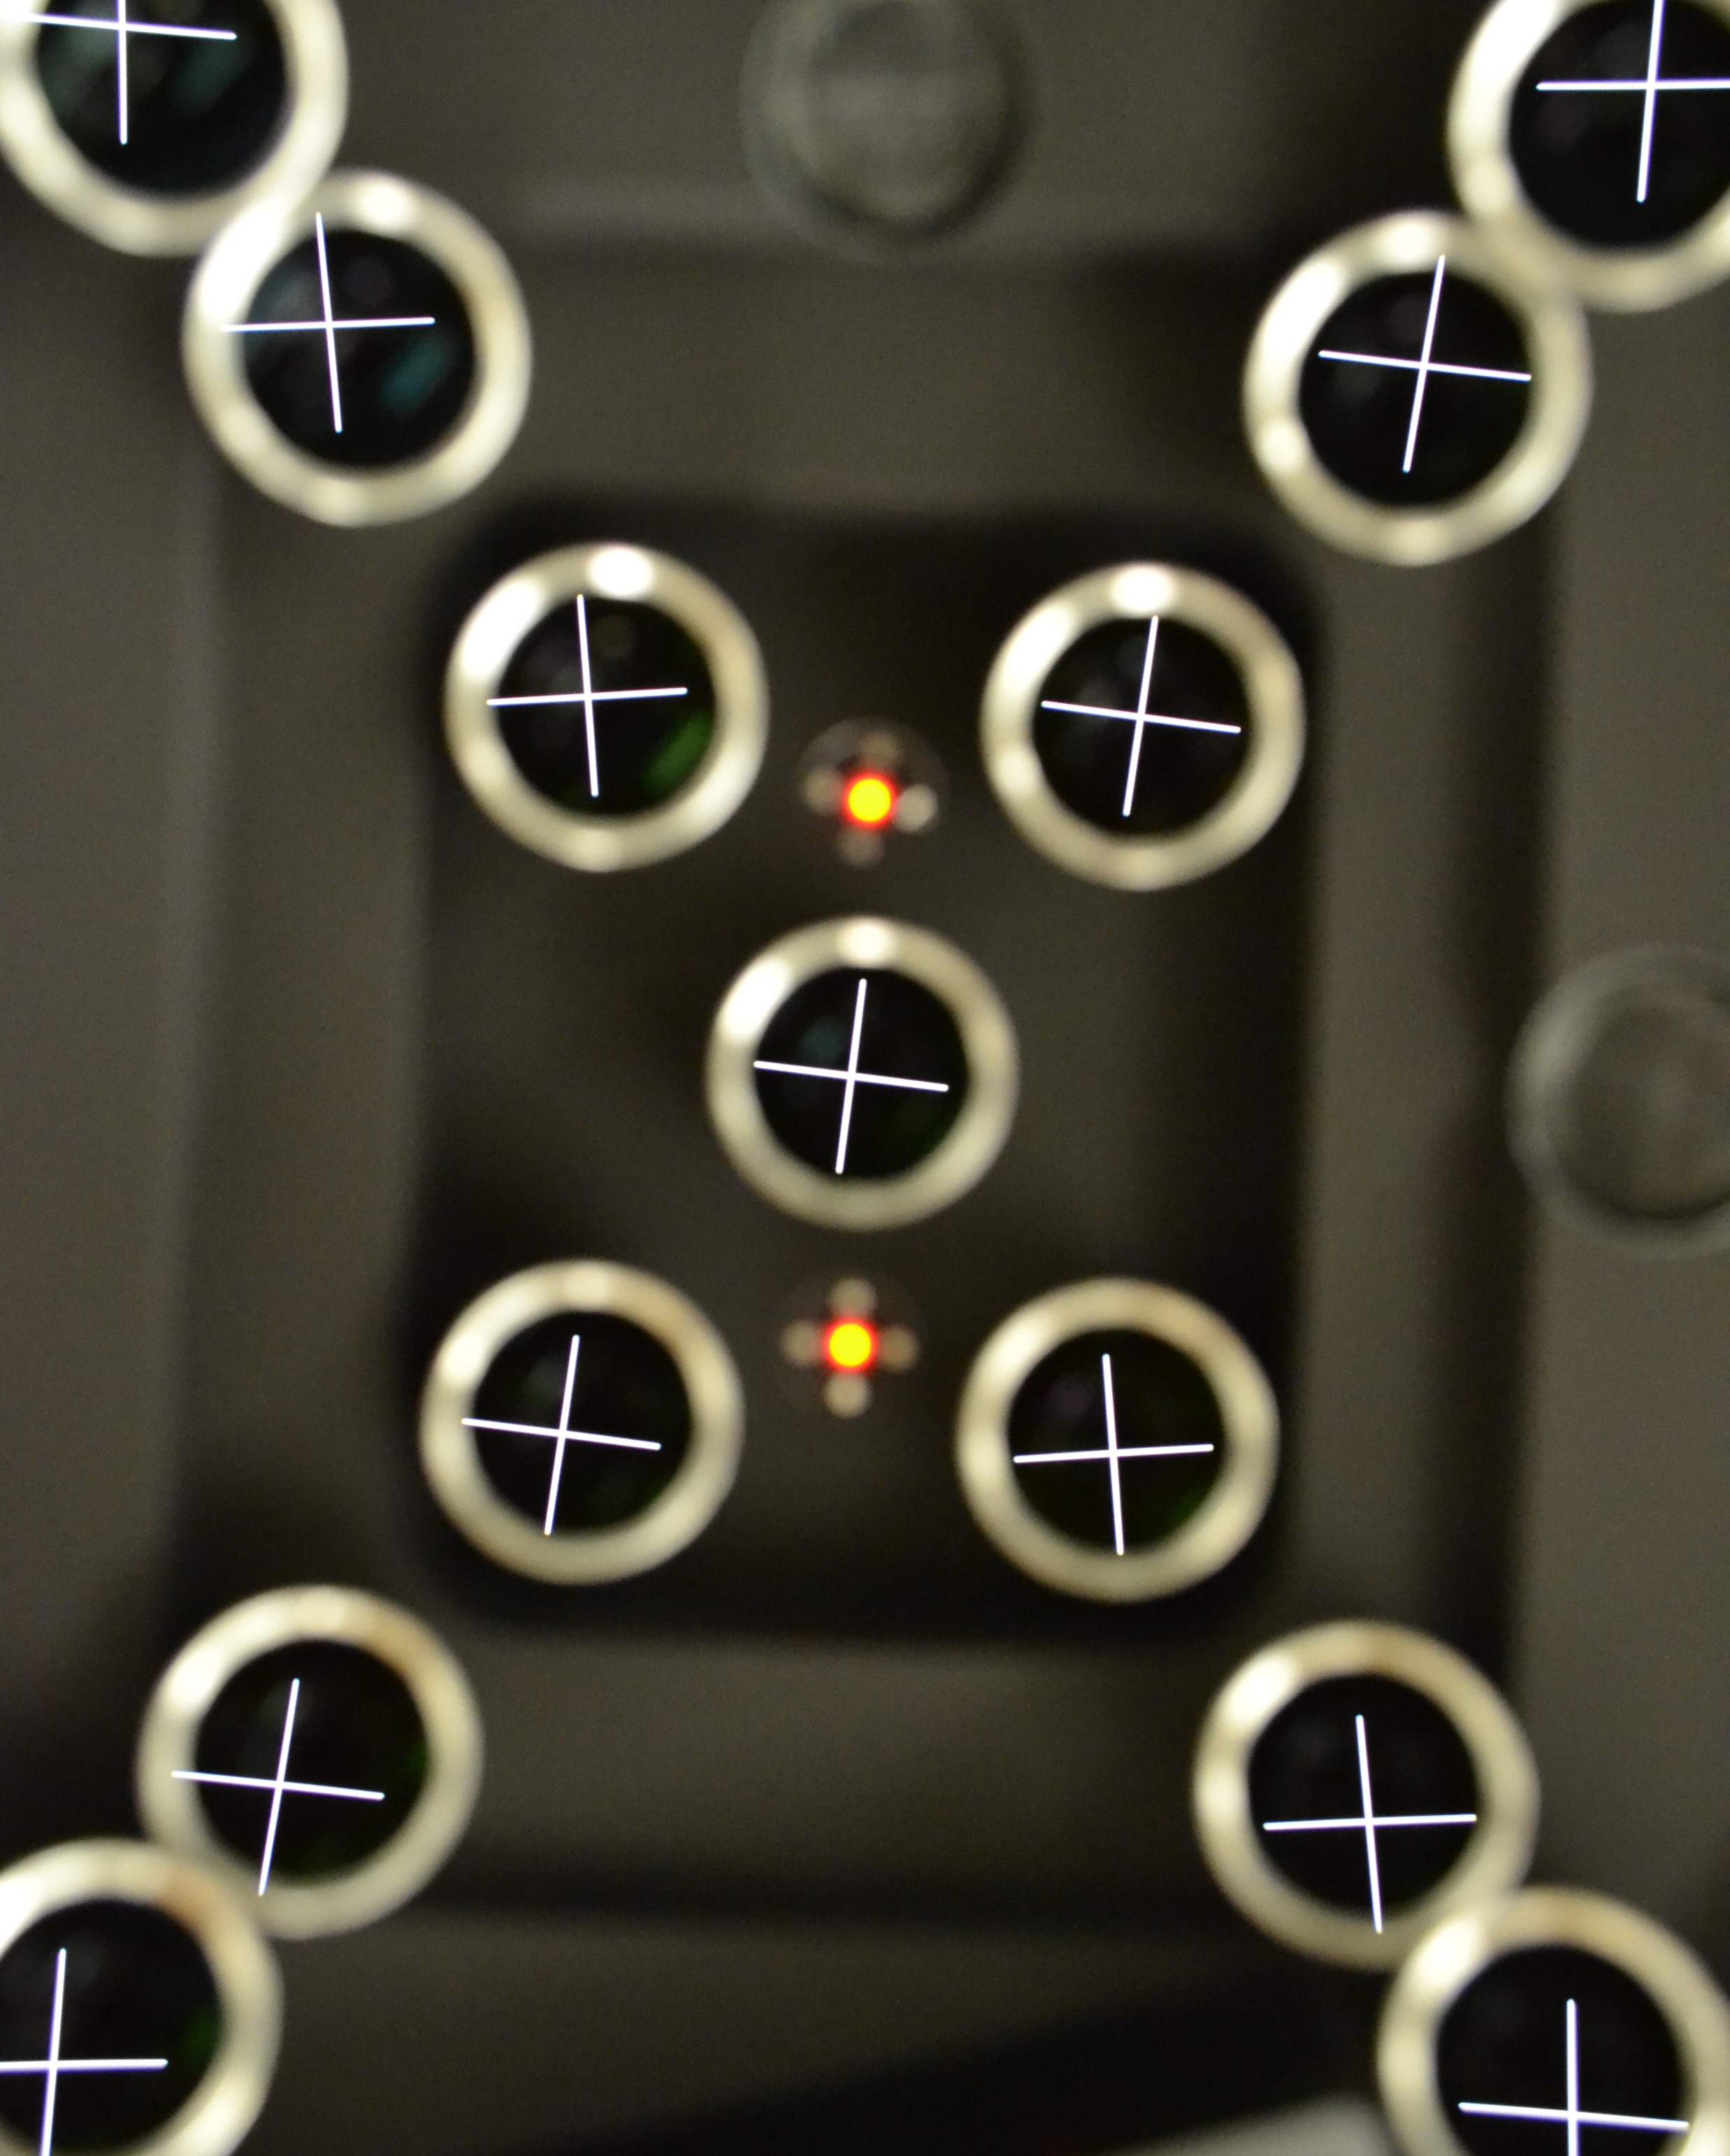
The measurement of object distance for projected virtual objects using a scanning pentaprism and digital alignment telescope
Kevin Sweeney SPIE Photonics West
David A. Imrie, PhD OPTO 13373-8

Slide 2

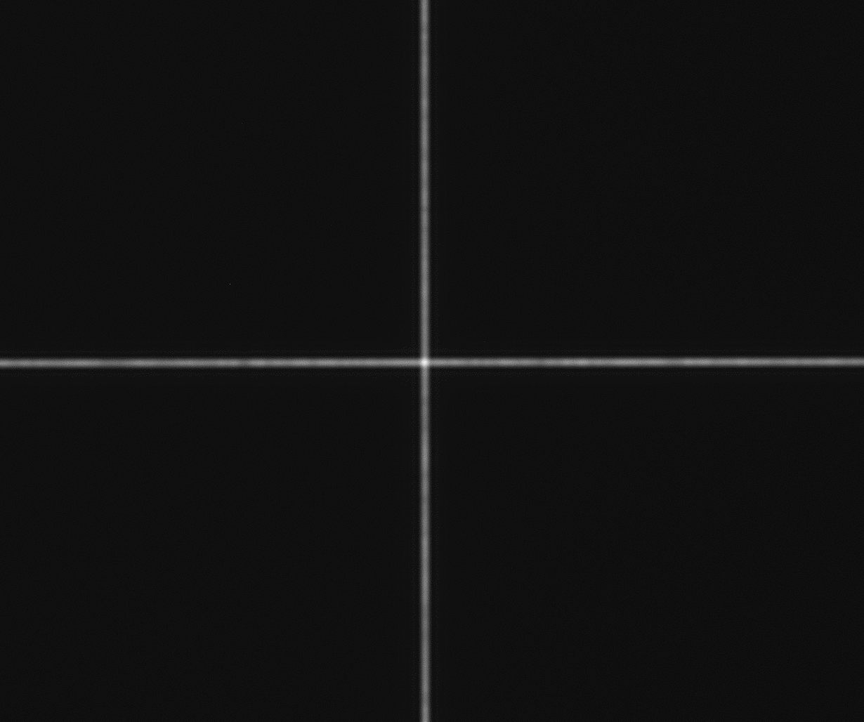
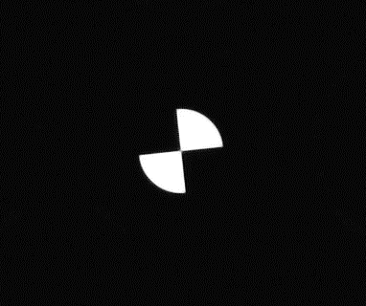
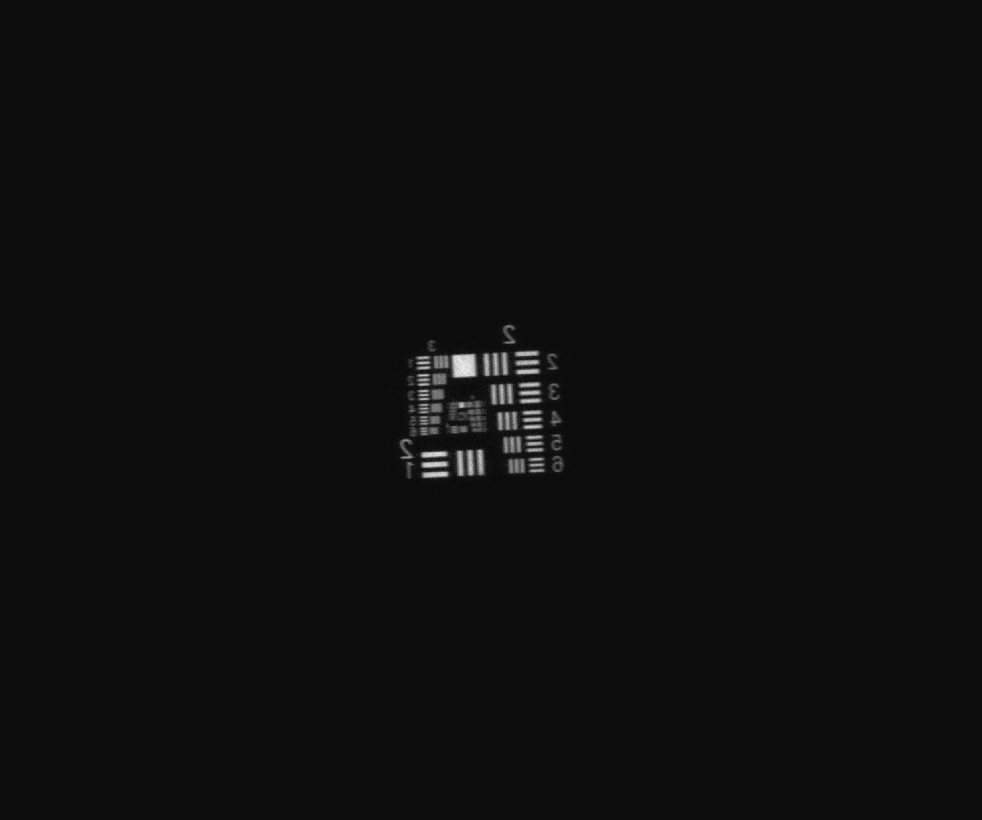
An imager test scenario must be with the use case.
Conjugate Distance
Aperture Size
Wavelength Spectrum
consistent
Target Shape
How do we ensure
regardless of ,
or ?
OPTO 13373-8

Slide 3
The Scanning Pentaprism has the versatility we need.
There are several methods for ensuring collimation…
 | Restriction
Method | Pinhole Source | Monochromatic Source | Instrument EFL >> Collimator EFL | Relay Optic > Collimator Aperture | Accommodating Features in Collimator
Laser Unequal Path Interferometer | ✖ | ✖ | ✓ | ✖ | ✖
Calibrated Camera | ✓ | ✓ | ✖ | ✖ | ✓
Shack-Hartmann Wavefront Sensor | ✖ | ✓ | ✓ | ✖ | ✓
Shear Plate Interferometer | ✖ | ✖ | ✓ | ✖ | ✓
Autocollimation | ✓ | ✓ | ✓ | ✖ | ✖
Scanning Pentaprism | ✓ | ✓ | ✓ | ✓ | ✓
OPTO 13373-8

Slide 4
A pentaprism provides a constant deflection angle.
Incoming light ray
Incoming light ray
90°
90°
Deflected light ray
Rotate Prism
Deflected light ray
Deflection angle is unchanged!

Slide 5
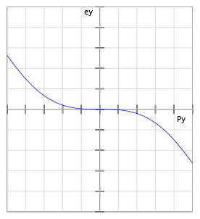
The Scanning Pentaprism Approach
Target Projector
Alignment telescope and collimator are rigidly affixed to each other.
  Moving only the pentaprism drastically reduces straightness required of the linear guideway
Location of the telescope image is proportional to angle of ray collected from target projector
Ray Fan Plot
Defocus
Telescope Image Location
Produces
Alignment Telescope + Scanning Pentaprism
Pentaprism Position
OPTO 13373-8

Slide 6









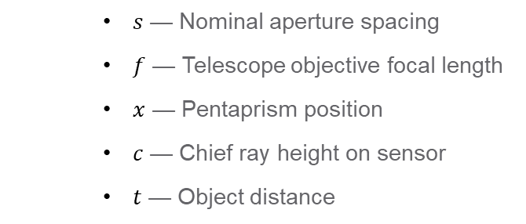



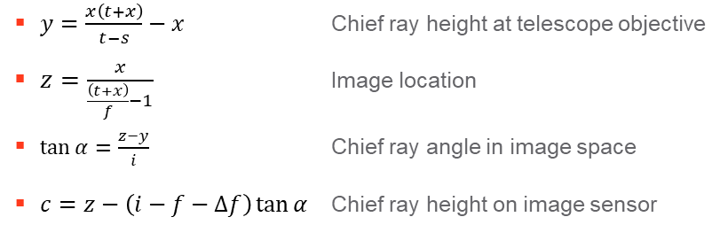
Geometrical Optics Analysis — See Manuscript
Pentaprism = Aperture Stop → Defines line of sight in object space
Unfolded
Line of Sight
$$θ$$
$$x$$
$$\left(f+Δf,c\right)$$
Line of Sight
Real or Projected Object
$$\left(−s−x,0\right)$$
$$\left(0,y\right)$$
Image
$$α$$
Real or Projected Object
$$s$$
$$\left(0,0\right)$$
$$\left(f,0\right)$$
$$\left(i,z\right)$$
Line of Sight
$$\left(−t−x,−x\right)$$
Scanning Pentaprism Aperture
Alignment Telescope Objective Lens
Image Sensor
Telescope Objective
$$c$$
Image Sensor
Known by design
  $s$ — Nominal aperture spacing
  $f$ — Telescope objective focal length
  $x$ — Pentaprism position
  $c$ — Chief ray height on sensor
  $t$ — Object distance
$y=\frac{x\left(t+x\right)}{t−s}−x$ Chief ray height at telescope objective
$z=\frac{x}{\frac{\left(t+x\right)}{f}−1}$ Image location
$\tan{α}=\frac{z−y}{i}$ Chief ray angle in image space
$c=z−\left(i−f−Δf\right)\tan{α}$ Chief ray height on image sensor
Monitored during operation
Quantity to be calculated
OPTO 13373-8

Slide 7
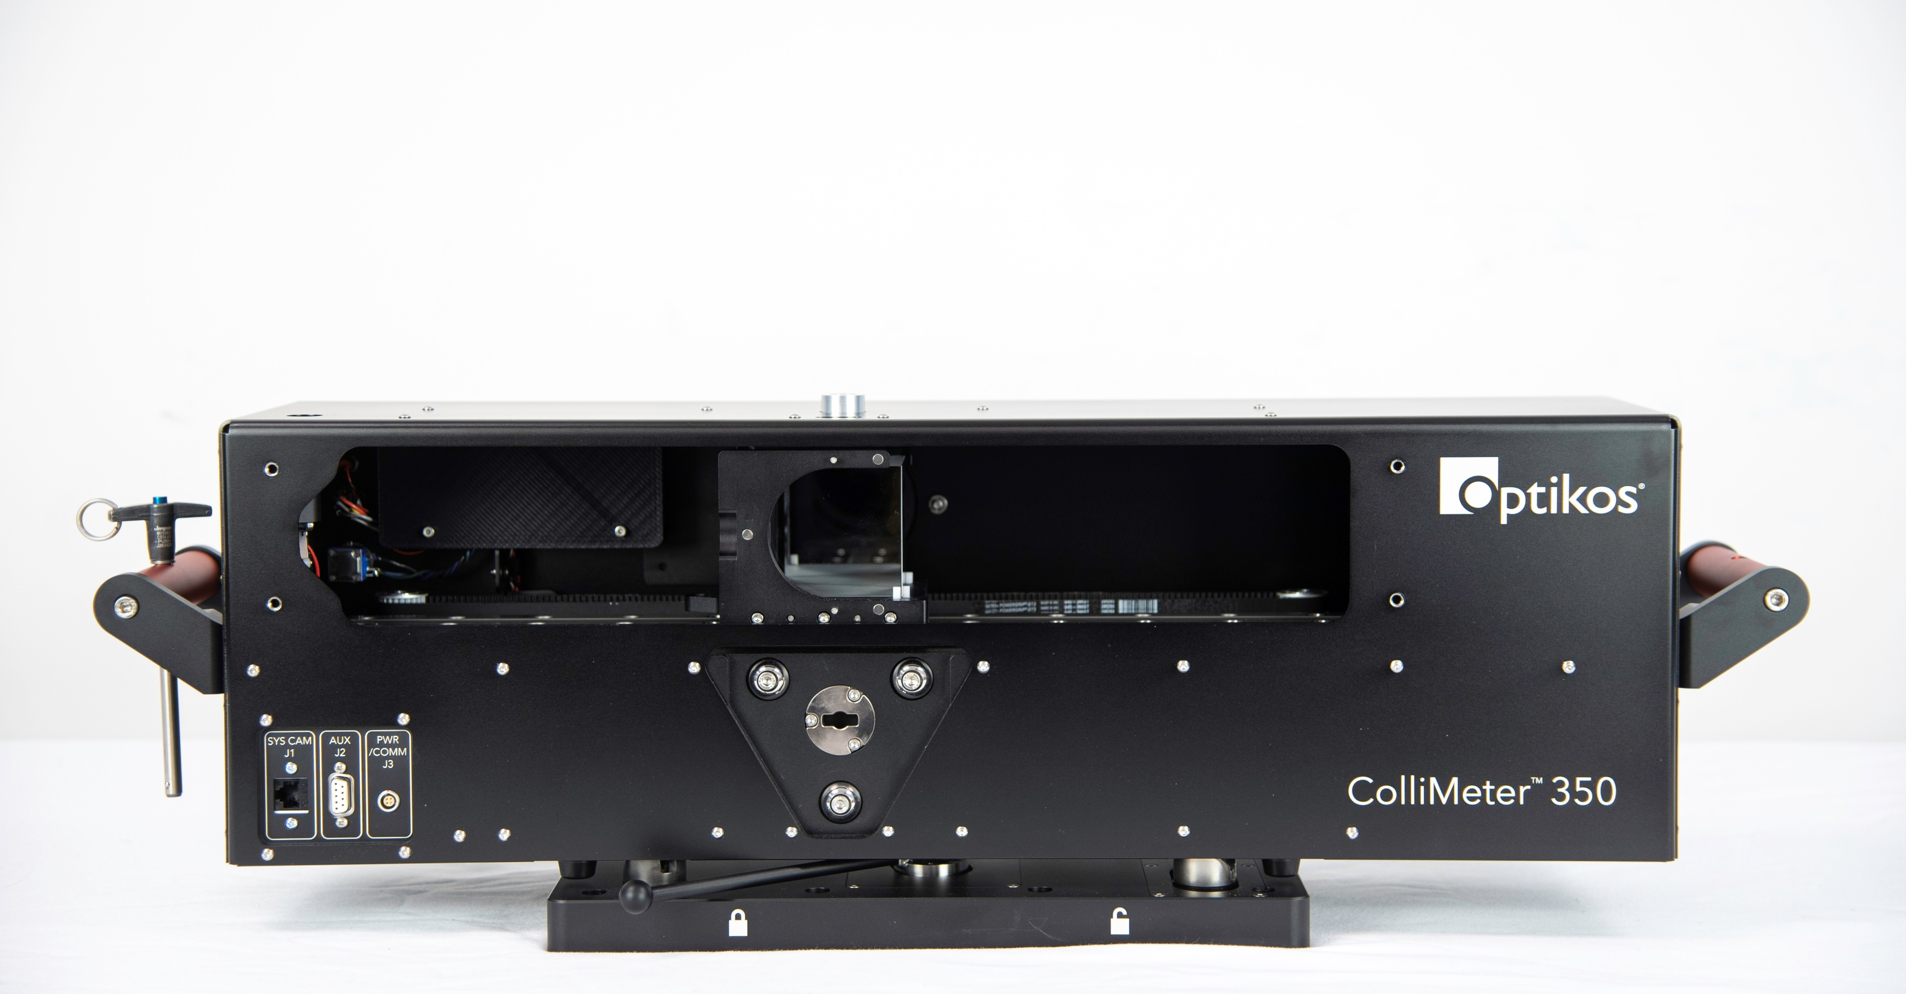
The Scanning Pentaprism Demonstrator
Scan Range
350 mm
Weight
16.9 kg
Pixel Subtense
2 arcsec
Full Field of View
1.38°
Spectral Range
300-1000nm
OPTO 13373-8

Slide 8
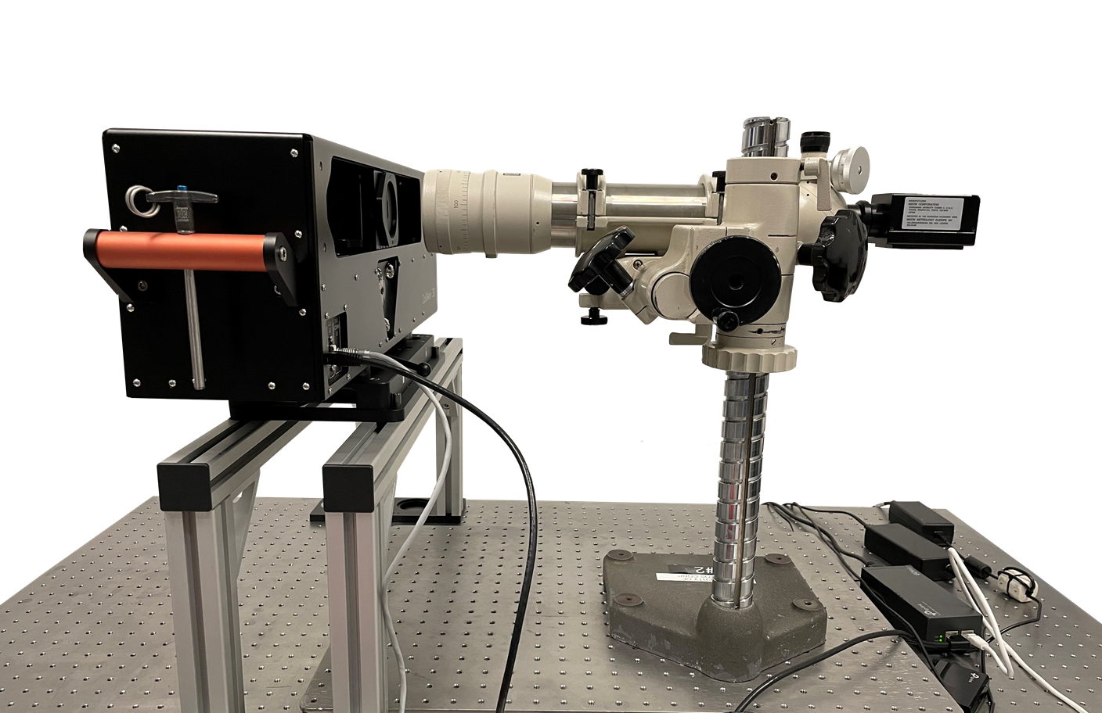
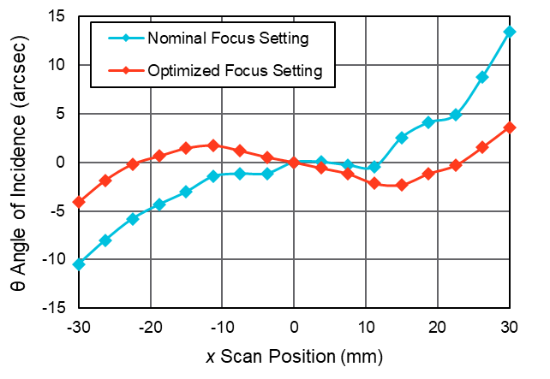
Compensating Spherical Aberration
Autocollimator Crosshair in Live Video
Focus Setting Adjustment
Measured Ray Fans
OPTO 13373-8

Slide 9
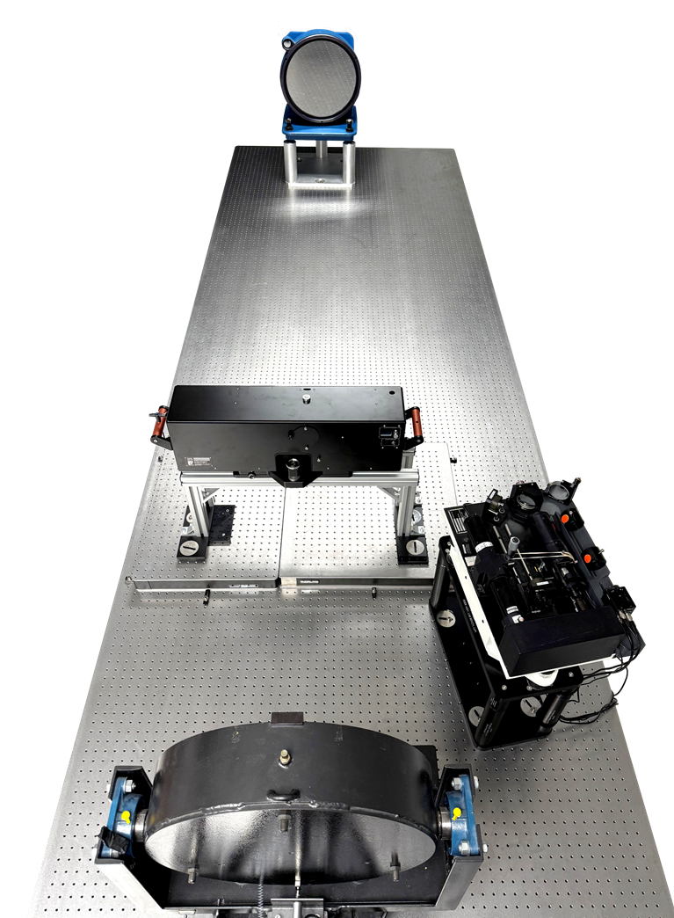
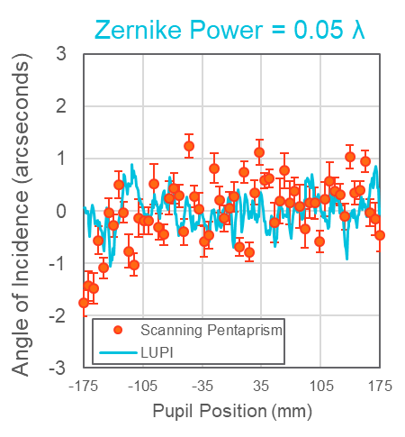
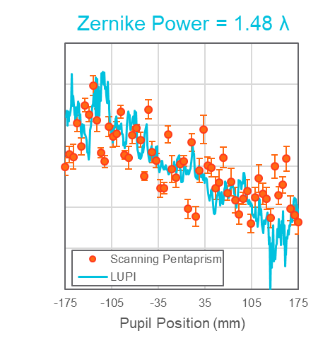
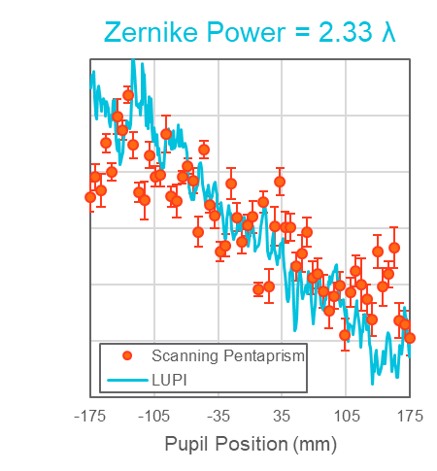
Measuring Departure from Collimation
350mm Reflective Collimator
Laser unequal path interferometer (LUPI) is both:
  Point source for collimation measurement
  Independent measurement of collimation
Scanning Pentaprism
Projected Distance > 35km
Projected Distance = 34km
Projected Distance = 23km
LUPI
Return Flat for LUPI
OPTO 13373-8

Slide 10
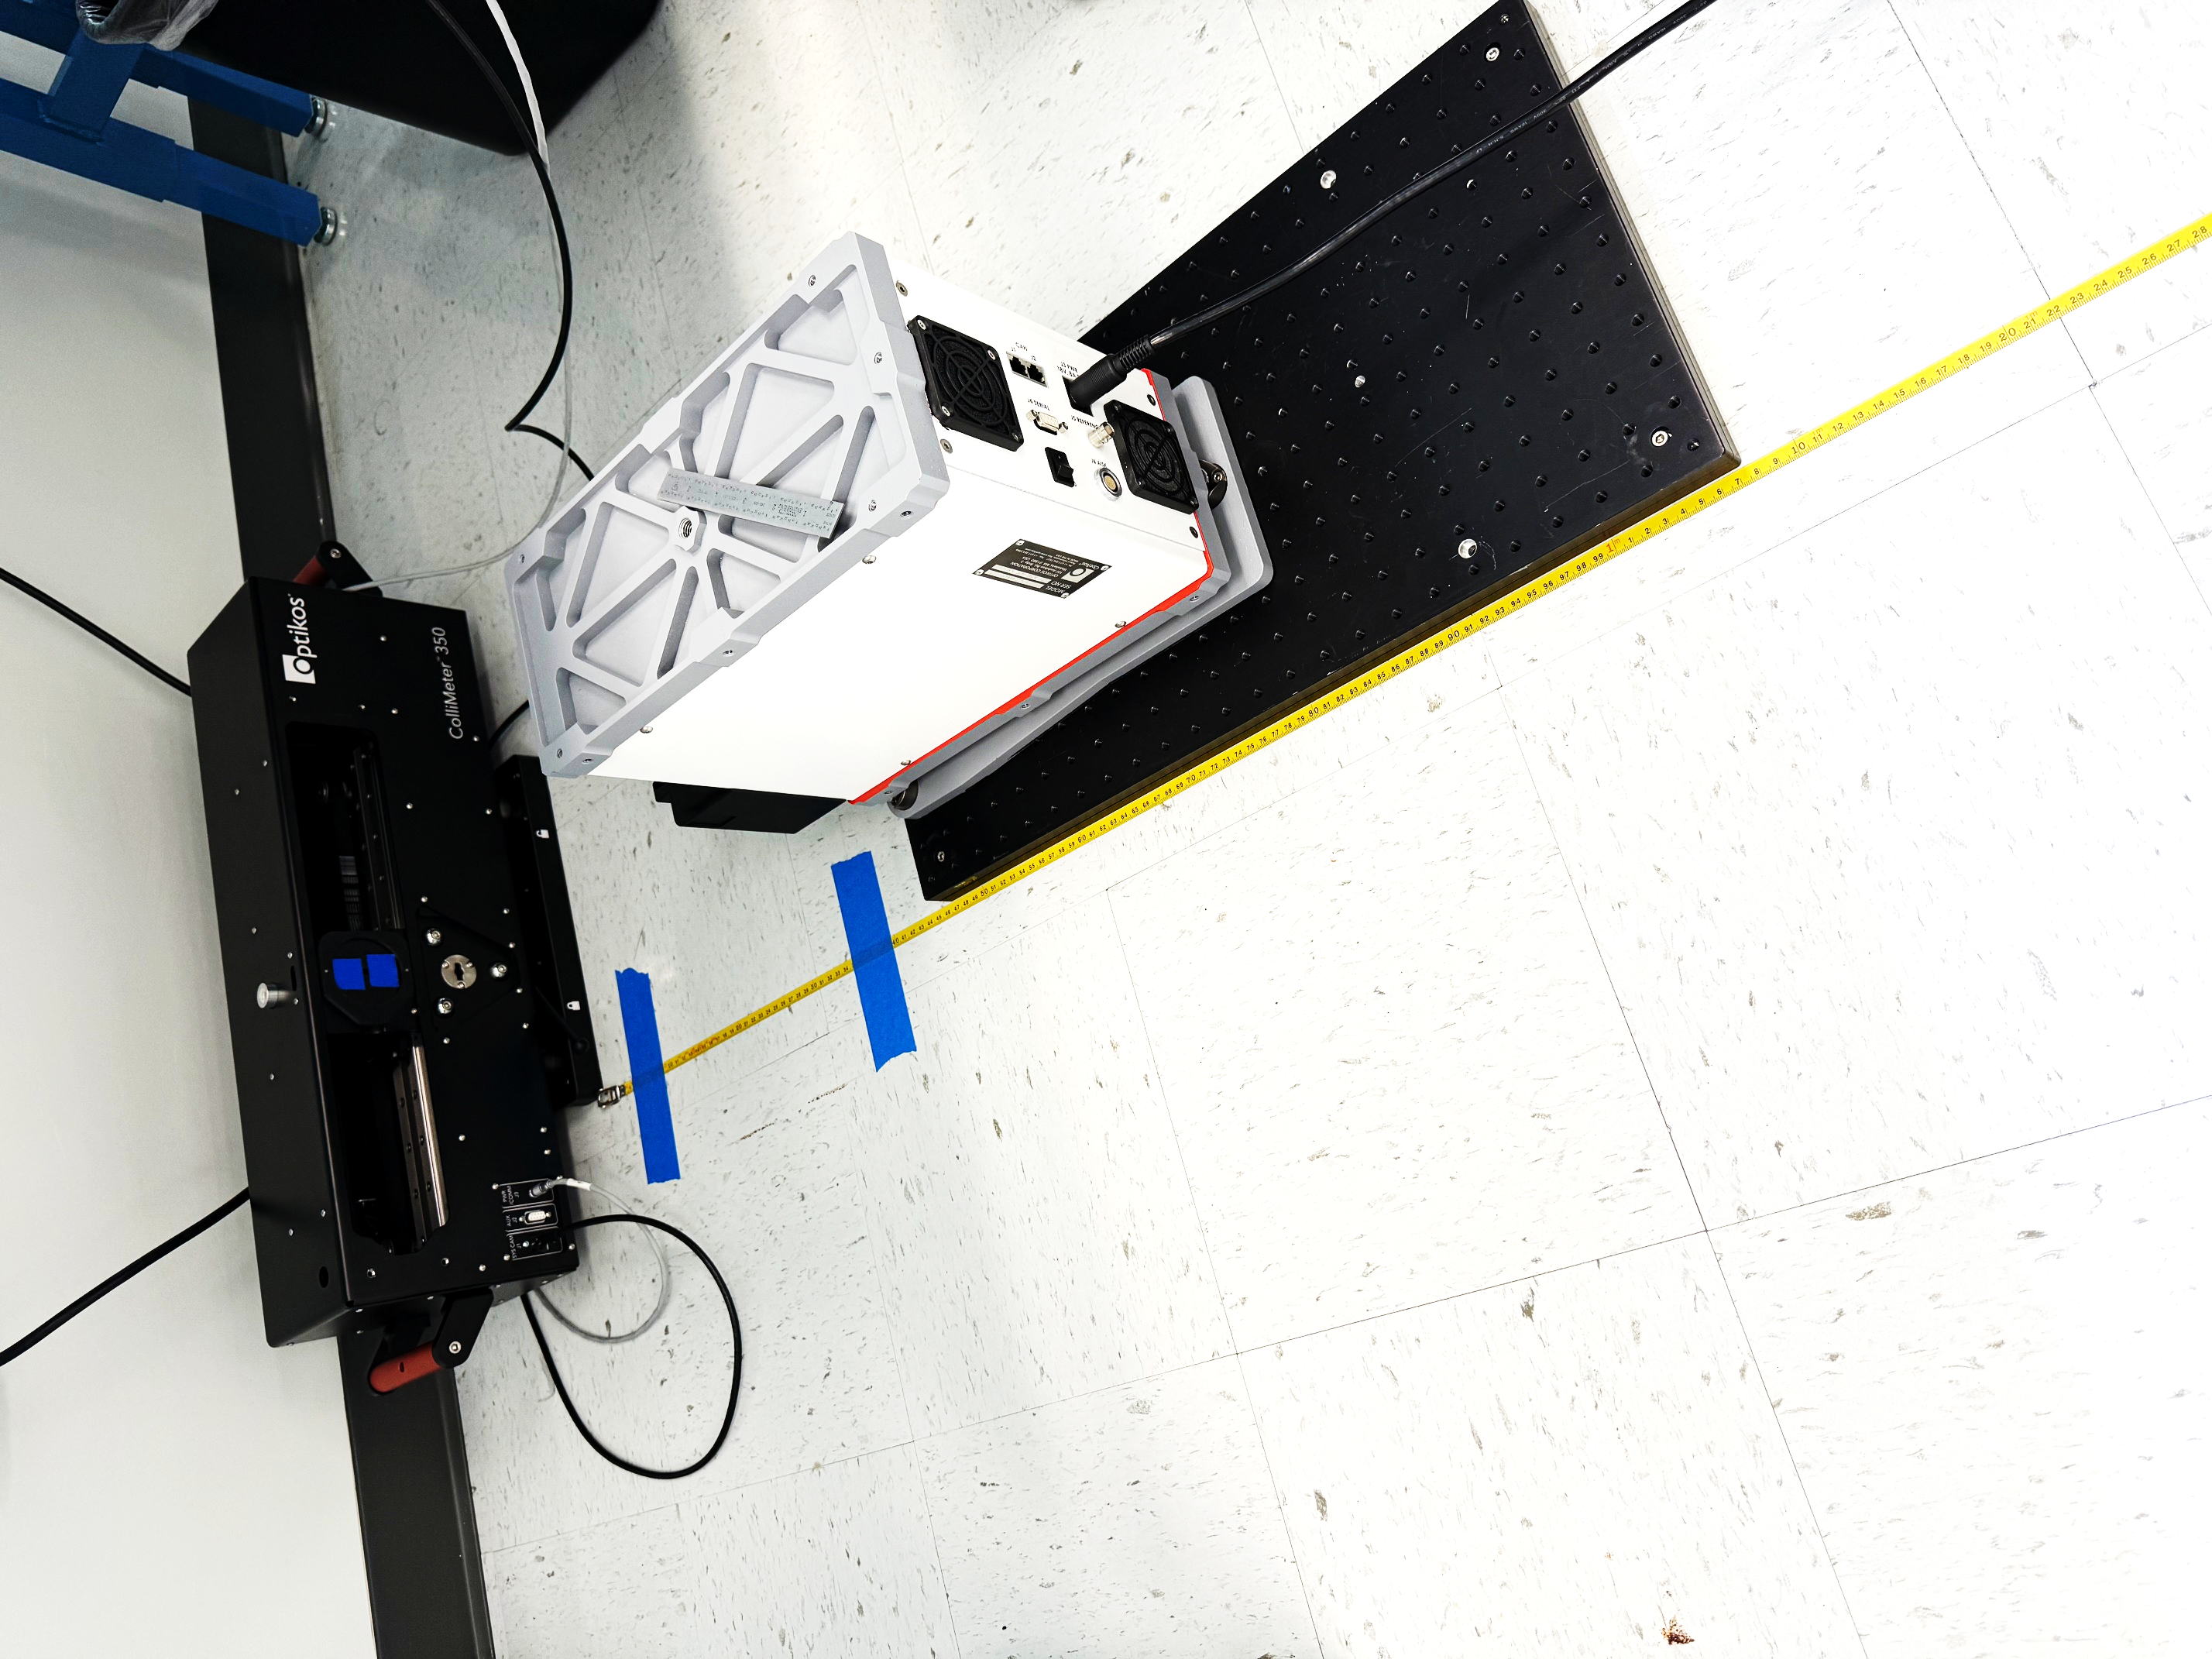
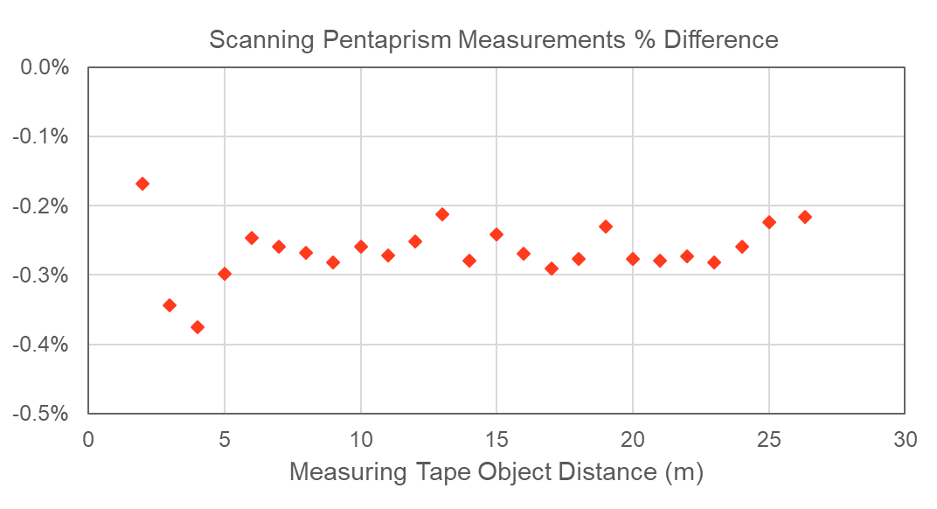
Measuring Finite Conjugates
White Light Point Source Generator
The scanning pentaprism is a versatile technique for determining conjugate distance of any optical beam!
Surveyor’s Tape Measure
OPTO 13373-8

Slide 11
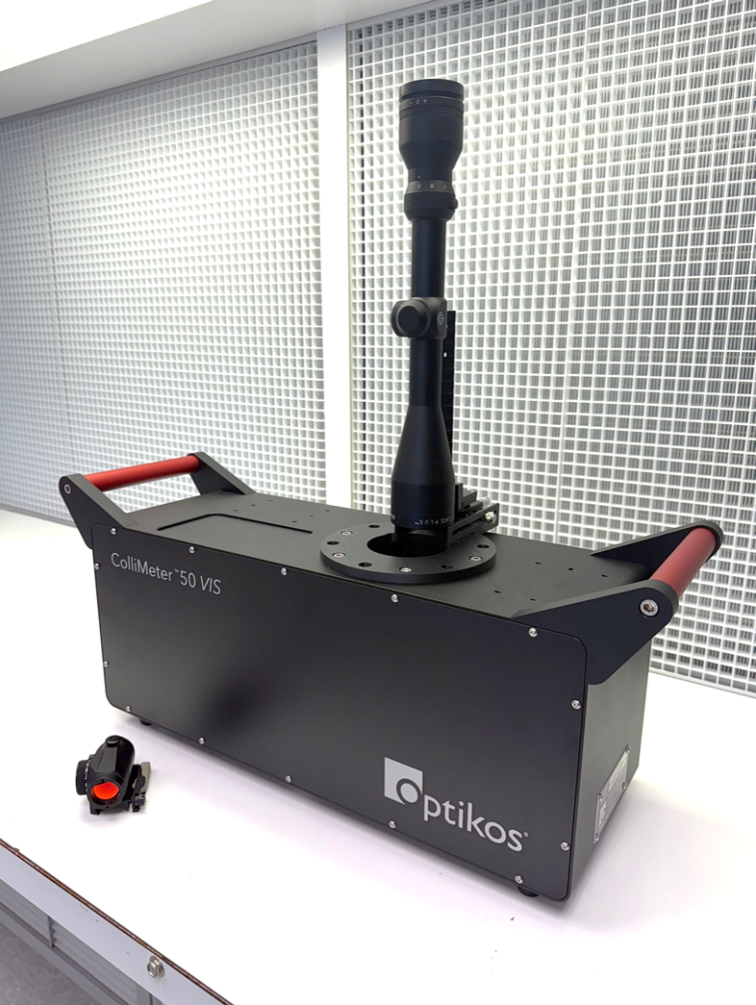
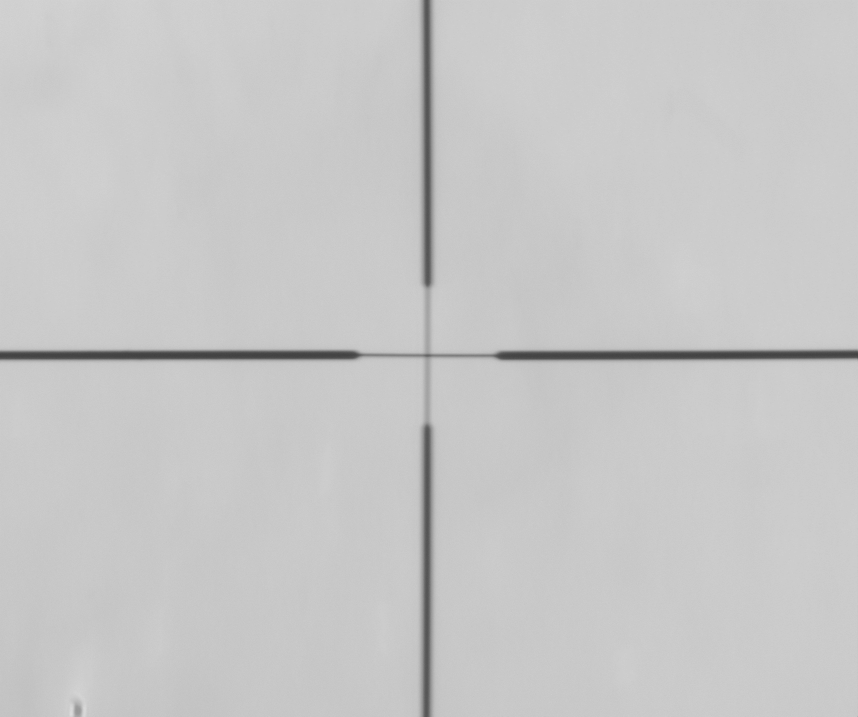
Measuring Parallax
The reticles of telescopic sights can be measured provided uniform background illumination.
For the case of rifle scopes, this can directly measure the “zero parallax distance” on the objective side of the scope.
OPTO 13373-8

Slide 12
Thank you!
Come see the scanning pentaprism instrument at Optikos booth #841
Acknowledgments
References
Lucas Delbanco
Design and build of the demonstrator
Michael Halligan
Design and build of demonstrator tip/tilt base
Dr. Jian Zhang
Software for motion control, image acquisition, and centroid tracking
Dr. Stephen D. Fantone
Funding and other resources at Optikos Corporation
Wetthauer and Brodhun, "Objektiv Untersuchungen," Zeitschrift für Instrumentenkunde, vol. 40, no. 5, pp. 96-97 (May 1920)
R. N. Wilson, ""Matching Error" (Spherical Aberration) in the Hubble Space Telescope (HST): Some Technical Comments," The Messenger, no. 61, pp. 22-24 (1990)
W. Scott Smith "Testing the 8.3-meter telescope optics", Proc. SPIE 2576, International Conference on Optical Fabrication and Testing, pp. 220-231 (August 1995); https://doi.org/10.1117/12.215597
P. Su, J. H. Burge, B. Cuerden, J. Sasian and H. M. Martin, "Scanning pentaprism measurements of off-axis aspherics," Proc. SPIE 7018, Advanced Optical and Mechanical Technologies in Telescopes and Instrumentation, 70183T (25 July 2008); https://doi.org/10.1117/12.789588
S. Qian, W. Jark, P. Z. Takacs, K. J. Randall and W. Yun, "In situ surface profiler for high heat load mirror measurement," Optical Engineering 34(2), pp. 396-402 (1 February 1995); https://doi.org/10.1117/12.194834
S. Qian, W. Jark and P. Z. Takacs, "The penta‐prism LTP: A long‐trace‐profiler with stationary optical head and moving penta prism," Review of Scientific Instruments, vol. 66, p. 2562–2569 (1995); https://doi.org/10.1063/1.1145658
K. von Bieren, "Pencil beam interferometer for aspherical optical surfaces," Proc. SPIE 0343 Laser Diagnostics, pp. 101-108 (19 November 1982); https://doi.org/10.1117/12.933743
P. C. V. Mallik, C. Zhao and J. H. Burge, "Measurement of a 2-meter flat using a pentaprism scanning system," Optical Engineering 46(2), 023602 (1 February 2007); https://doi.org/10.1117/1.2700386
Optics and optical instruments — Accuracy of optical transfer function (OTF) measurement, ISO 11421:1997(E), Geneva, Switzerland, (September 15 1997)
K. Mohammadi, Y. S. Lee and T. Jennewein, "Characterization of optical aberrations with scanning pentaprism for large collimators," CLEO: Applications and Technology, Imaging Techniques Across Multiple Modalities and Dimensions (ATh1D), San Jose, 2022.
OPTO 13373-8

